Slide 1
Methylation of ARTS promoter is responsible for its silencing in several types of cancer
Research Project
Dana Mamriev
Supervisor: Prof. Sarit Larisch, University of Haifa

Slide 2
Programmed cell death-
Apoptosis
Essential process occurring in all multi-cellular organisms which leads to "cell suicide"
Keeps a steady state cell numbers in tissues
Serves as a major defense mechanism that protects the organism from mutations that can cause uncontrolled division leading to cancer

Slide 3
The major executioners of apoptosis are caspases- a family of enzymes that function as proteases.

Slide 4
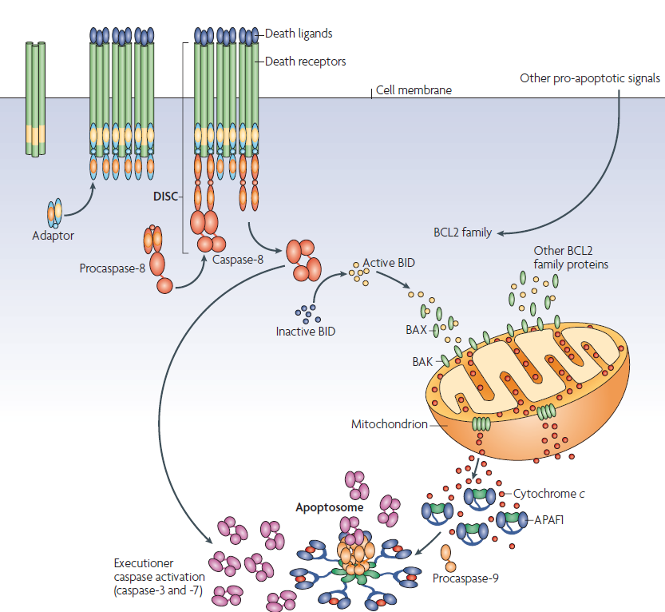
Two major signaling pathways are responsible for induction of apoptosis in cells: The External and the Mitochondrial pathway
Ow Y-L.P. et al. Nature 2008.

Slide 5
The Mitochondrial pathway
Responsible for most processes of apoptosis in most cells.
The apoptotic process is controlled through the action of both activators and inhibitors of caspases(Inhibitors of apoptosis- IAP) proteins.
IAP-antagonists are mitochondrial proteins which bind and antagonize IAPs leading to the release of active caspases bound by IAPs
Release of pro-apoptotic factors, including Cytochrome C and Smac/Diablo (SMAC), from the mitochondrial intermembrane space to the cytosol promotes caspases activation

Slide 6
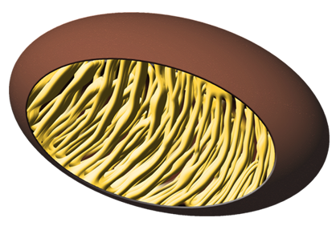
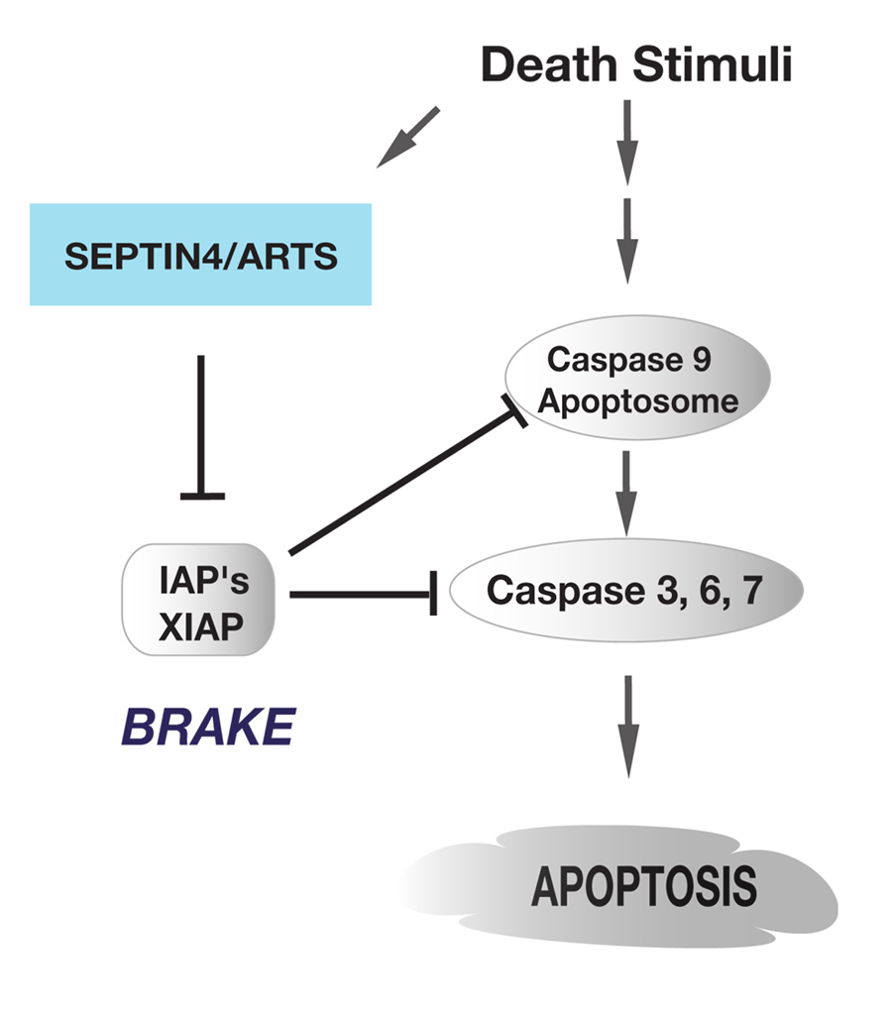
Apoptosis trigger
Cytochrome C
IAP -Antagonists

Slide 7
ARTS- a mitochondrial pro-apoptotic protein-initiates caspase activation upstream of MOMP
ARTS is a mitochondrial protein which is derived by differential splicing of the human Septin 4 (Sept4) gene
ARTS acts as an XIAP-antagonist to initiate caspase activation and apoptosis.
ARTS uses unique sequences to bind XIAP and promote its degradation leading to apoptosis
High levels of ARTS alone are sufficient to promote apoptosis in many cancer cell lines

Slide 8
*By Edison et al.2012

Slide 9
ARTS functions as a Tumor suppressor protein, which is silenced in many types of cancers
ARTS expression is frequently lost in acute lymphoblastic leukemia patients
Leukemic cells lacking ARTS were resistant to apoptotic induction
Deletion of the mouse Sept4 gene, which encodes ARTS, promotes tumor development

Slide 10
ARTS protein is lost in 75% of ALL patients
Healthy donor
Pre-B ALL
T-ALL
Elhasid et al, Oncogene, 2004

Slide 11
ARTS mRNA is frequently silenced in human lymphoma patients
Garcia-Fernandez et al., Genes & Dev, 2010
Notes:
11

Slide 12
Methylation
A Genetic process that inhibits expression of proteins
Methyl group is added to a cytosine or adenine DNA nucleotides
In mammals the methyl group is usually added to the cytosine in a CG dinucleotide, in regions called “CpG islands”
The enzyme which is adding methyl groups to the carbon-5 position of a specific cytosine residue is DNA Methyltransferase
DNA methylation has an important role in the regulation of gene expression and chromatin organization within normal eukaryotic cells (the methylation control DNA accessibility for transcription)
When the regulation of the methylation disrupts the gene expression is changing and tumor suppressor gens may be silenced.
DNA methylation is one of the known mechanisms for inactivating tumor suppressor genes
Methylation found to be the main mechanism responsible for the loss of ARTS expression in leukemia and lymphoma patients

Slide 13
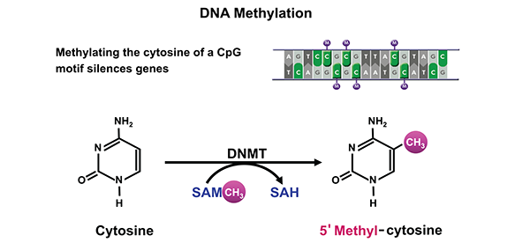
Schematic representation of DNA methylation, which converts cytosine to 5’methyl-cytosine via the actions of DNA methyltransferase (DNMT). DNA methylation typically occurs at cytosines that are followed by a guanine
*By Samir Zakhari Ph.D. from the review “Alcohol Metabolism and Epigenetics Changes”

Slide 14
Hypothesis:
A common feature of most cancers is the loss of their ability to undergo apoptosis. One mechanism leading to that is by silencing tumor suppressor proteins which promote apoptosis. We assumed that if we will restore expression of ARTS by demethylation in these cells it will lead to specific apoptosis of these cancer cells.

Slide 15
Work aims:
To identify certain cancer cell lines in which ARTS expression is not detectable.
To show that methylation of ARTS promoter is responsible for silencing ARTS expression. And that demethylation of ARTS promoter restores the expression of ARTS in these cancer cells.

Slide 16
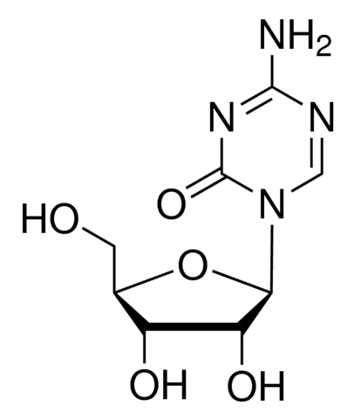
5-Azacytidine (5-Aza) C₈H₁₂N₄O₅
Is a chemical analogue of the cytosine nucleoside
Inhibited DNA methylation- demethylation agent
Use to demonstrate the correlation between loss of methylation in specific gene regions and activation of the associated genes
Incorporated into DNA, inhibits DNMT activity to induce DNA hypomethylation

Slide 17
Testing the effect of 5-AZA on ARTS RNA expression:
Experimental procedure
Cells were seeded and treated with 10 μM of
5-Aza for 72 hours. Cells that were not treated with 5-AZA were served as negative control
RT-PCR method were used to determine the mRNA levels of ARTS
RNA was isolated from the treated and untreated cells
cDNA were amplified with specific primers for ARTS by PCR reaction
Specific primers for Actin were served as positive control for cDNA synthesis and negative control for demethylation
PCR products were analyzed using gel electrophoresis to determine if ARTS expression can be rescued using demethylation
Densitometry analyzes comparing values of ARTS to Actin quantified the expression levels of ARTS in response to treatment of 5-Aza

Slide 18
The cells that were examined
A375- human epithelial malignant melanoma cell line
UACC- human breast epithelial primary ductal carcinoma
HepG2- human hepatocellular carcinoma

Slide 19
Results:
ARTS promoter is methylated in A375, UACC and HepG2 cell lines

Slide 20
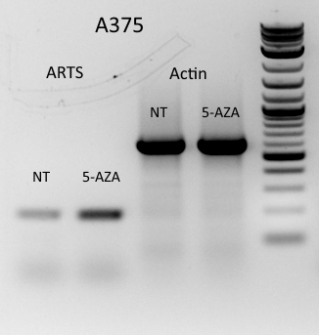
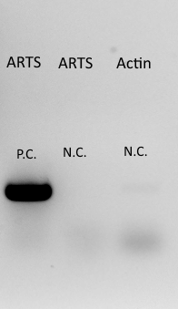
ARTS expression is increased with the exposure to 5-Aza at the RNA levels in A375 cell line
610 bp
192 bp
P.C- for positive control we used plasmid with ARTS gens.
N.C- for negative control the sample contained primer for ARTS without cDNA
N.T- Untreated cells with 5-aza
18 times increase in A375 treated cells
A375 is a human epithelial malignant melanoma cell line

Slide 21
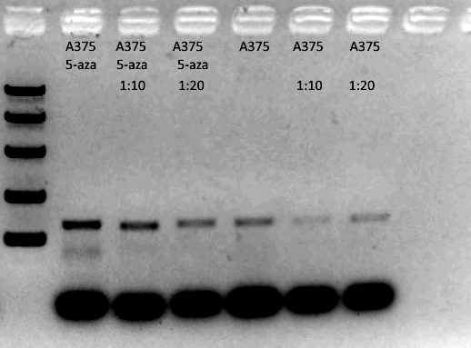
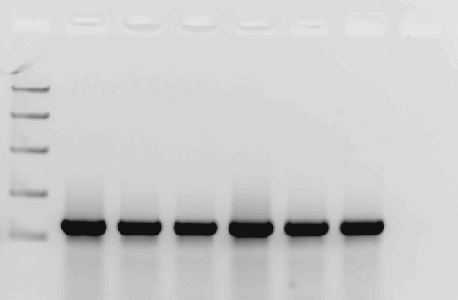
5-Aza treatment caused demethylation of ARTS promoter in a dose depended manner in A375 cell line
1
2
3
1
2
3
192 bp
1
Actin
1- Exp1 10 µM of 5-Aza
2- Exp2 1 µM of 5-Aza
3-Exp3 0.1 µM of 5-Aza
2

Slide 22
5-Aza treatment caused demethylation of ARTS promoter in a dose depended manner in A375 cell line

Slide 23
ARTS expression increases with the exposure to 5-Aza at the RNA levels in UACC cell line
192 bp
Actin
8 times increase in UACC cells
UACC is a human breast epithelial primary ductal carcinoma

Slide 24
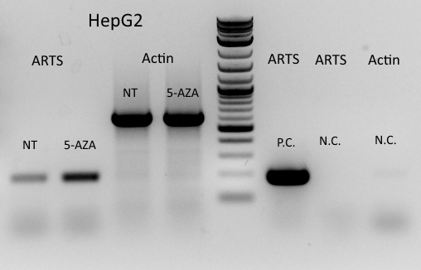
ARTS expression increases with the exposure to 5-Aza at the RNA levels in HepG2 cell line
610 bp
192 bp
P.C- for positive control we used plasmid with ARTS gens.
N.C- for negative control the sample contained primer for ARTS without cDNA
N.T- Untreated cells with 5-aza
23 times increase in HepG2 cells
HepG2 is a human hepatocellular carcinoma

Slide 25
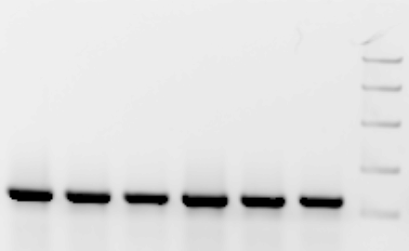
5-Aza treatment causes demethylation of ARTS in dose depended manner in HepG2 cell line
3
2
1
3
2
1
2
1
2
192 bp
1
Actin
1- Exp1 10 µM of 5-Aza
2- Exp2 1 µM of 5-Aza
3-Exp3 0.1 µM of 5-Aza

Slide 26
5-Aza treatment causes demethylation of ARTS in dose depended manner in HepG2 cell line

Slide 27
ARTS RNA Analysis-summary results
A major increase in ARTS RNA expression levels was seen in HepG2, A375 and UACC cells.

Slide 28
To test the effect of 5-Aza on protein levels of ARTS we used the following methods:
A375, UACC, HCT and Sk-mel Cell lines were seeded and treated with 10 μM of 5-AZA for 72 hours
The treated and untreated cells were lysed and run on SDS-PAGE
Results were analyzed using Western-bloot with specific monoclonal anti-ARTS antibodies (SIGMA)
Actin served as loading control
Densitometry analyzes comparing values of ARTS to Actin quantified the expression levels of ARTS in response to treatment of 5-AZA

Slide 29



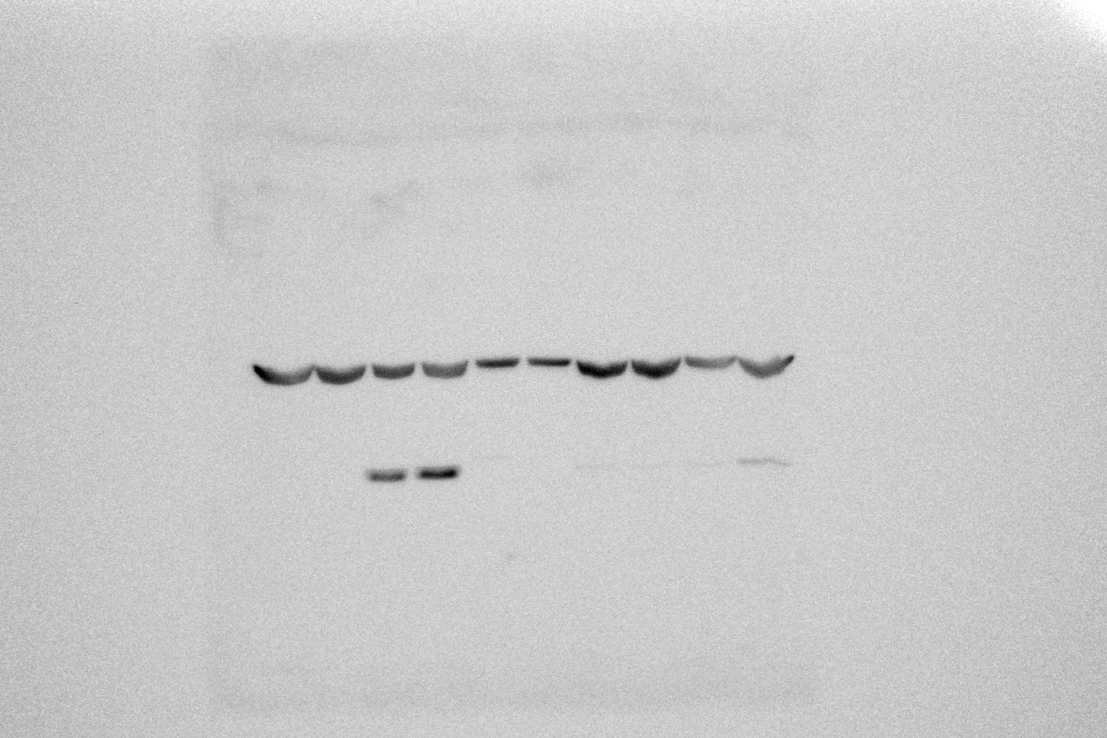
The effect of 5-Aza on ARTS Protein expression levels in A375 an HCT cells
Cell line
A375
HCT
-
+
-
+
5-AZA
Protein
Actin
10 µM5-aza
1.7 times increase
2.7 times increase

Slide 30
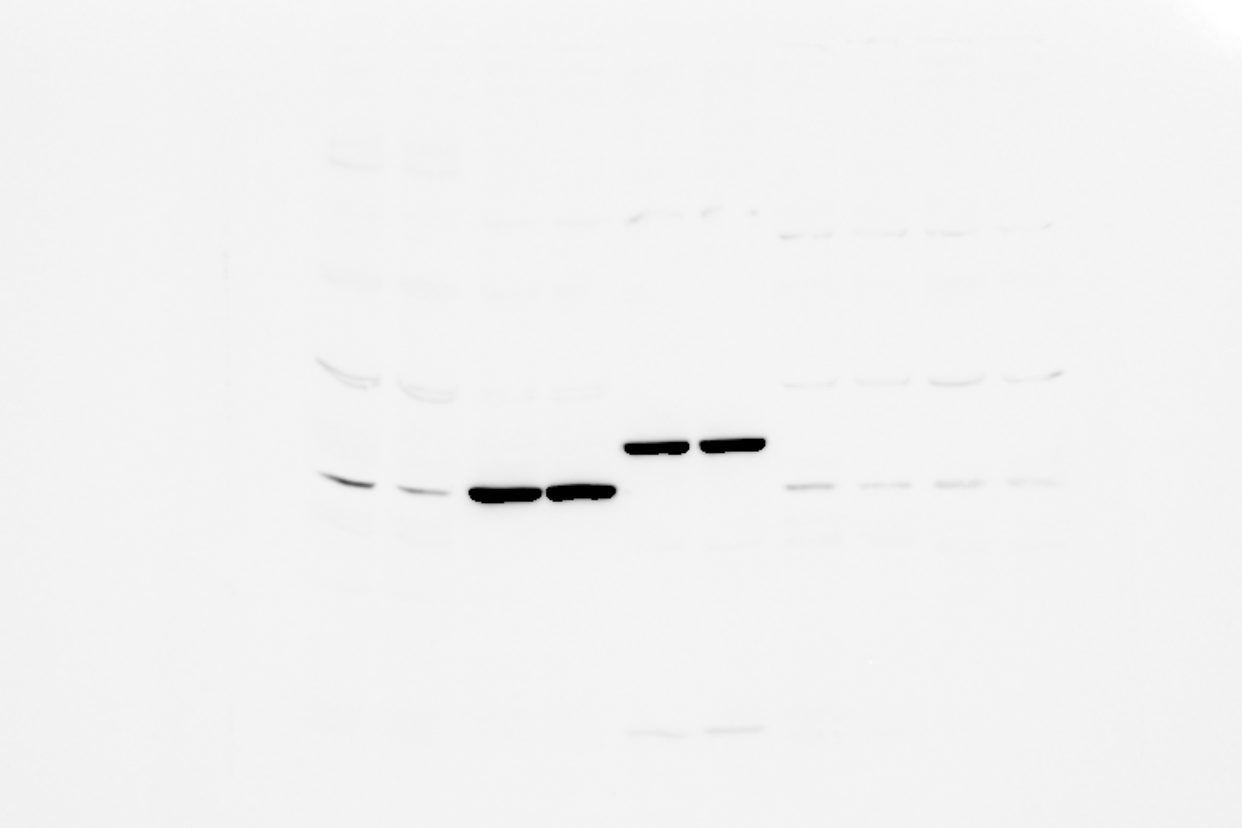

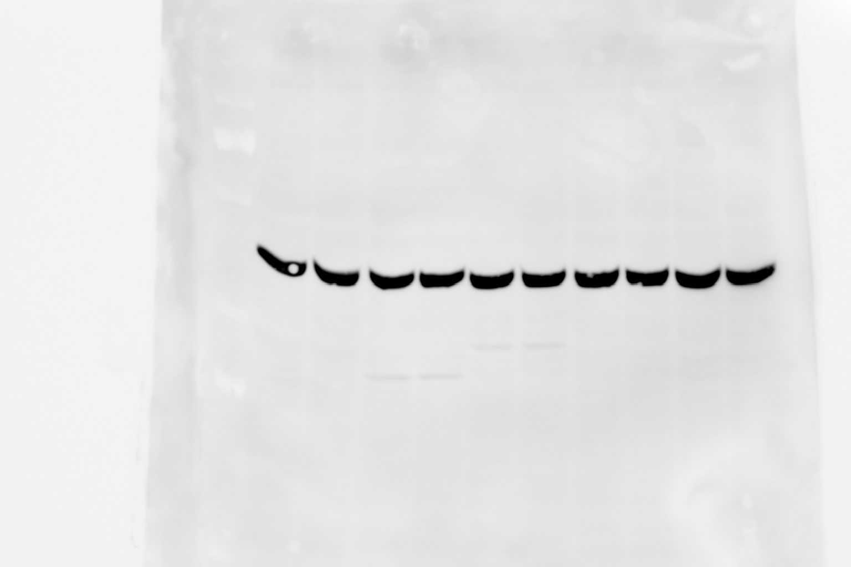
The effect of 5-Aza on ARTS Protein expression levels in Sk-Mel and UACC cells
Sk-mel
UACC
Cell line
-
+
-
+
5-AZA
ARTS
Actin
3.6 times increase
1.4 times increase

Slide 31
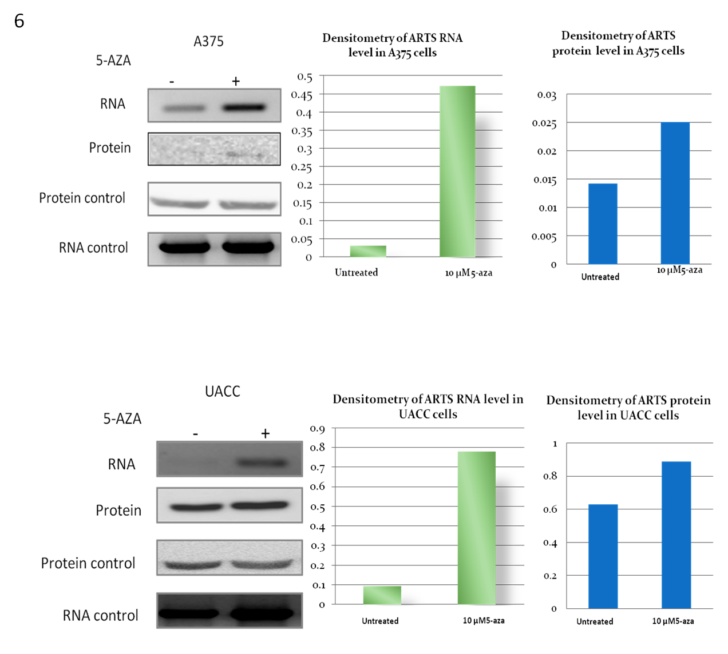
Comparing our results at the RNA level of ARTS expression with its protein expression shows that in A375, UACC cell lines a strong up stream regulation of ARTS at RNA and protein levels

Slide 32
ARTS protein Analysis-summary
We saw an increase in ARTS protein expression in the treated cells
3.6 times for sK-Mel
2.7 times for HCT
And 1.4 times for UACC
The effect of 5-AZA at the protein level was much smaller than the effect at the RNA levels
These findings suggest that additional regulation mechanisms control the levels of ARTS in these cell lines at the protein levels

Slide 33
Post translational modifications such as degradation could explain the smaller effect seen in the 5-AZA treated cells at the protein levels as compared to the more significant effect seen at the RNA level

Slide 34
Conclusions:
1. Silencing of ARTS occurs through methylation in several solid tumor cell lines:
A375 (melanoma), UACC (ductal carcinoma),HepG2 (hepatocellular carcinoma), HCT (colorectal carcinoma), and Sk-Mel (melanoma)
2. Post translational modifications such as Ubiquitin-Proteasome degradation of ARTS (published) could explain the smaller effect seen in the 5-AZA treated cells at the protein levels as compared to the more significant effect seen at the RNA level

